Slide 1
Panther Run Biology EOC Review
Day #2 ~ Mitosis, Meiosis, Genetics

Slide 2
DNA

Slide 3
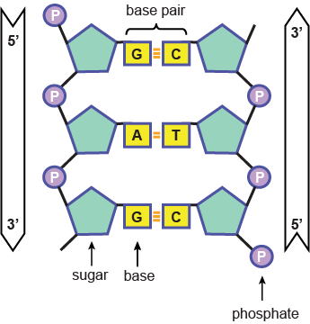
What is DNA?
We know:
DNA is the hereditary material
DNA has a double helix structure
Made of four bases; A,T,C,G
Sugar-Phosphate backbone
DNA replication is semi-conservative

Slide 4
Timeline of Experiments
1871 – Miescher – identifies Nucleic Acid
1928 – Griffith – “transformation” of bacteria
1944 – Avery, MacLeod and McCarty – DNase exp.
1950 – Chargaff – G&C, A&T
1952 – Hershey and Chase – Blender exp.
1953 – Franklin – picture of DNA
1953 – Watson & Crick – Double Helix structure and base pairing

Slide 5
Friedrich Miescher
1871
Isolates a type of acid
From white blood cells of bandages
Coins the term Nucleic Acid – because it was found in the Nucleus of the cell
Most people thought proteins were hereditary material, so no one cared.

Slide 6
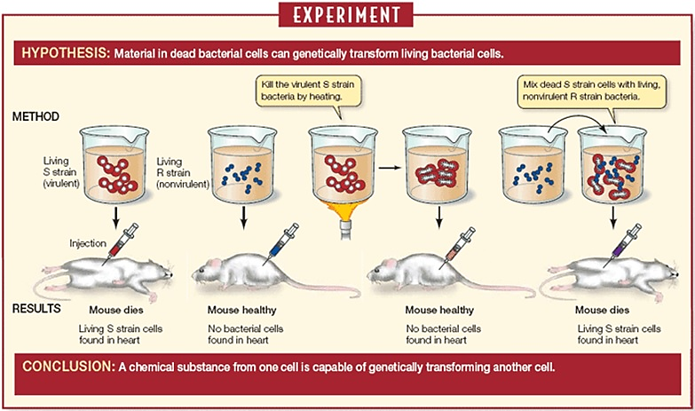
Frederick Griffith
1928
Transforming factor in bacteria

Slide 7
Avery, MacLeod, McCarty
1944
DNase vs. Protease

Slide 8
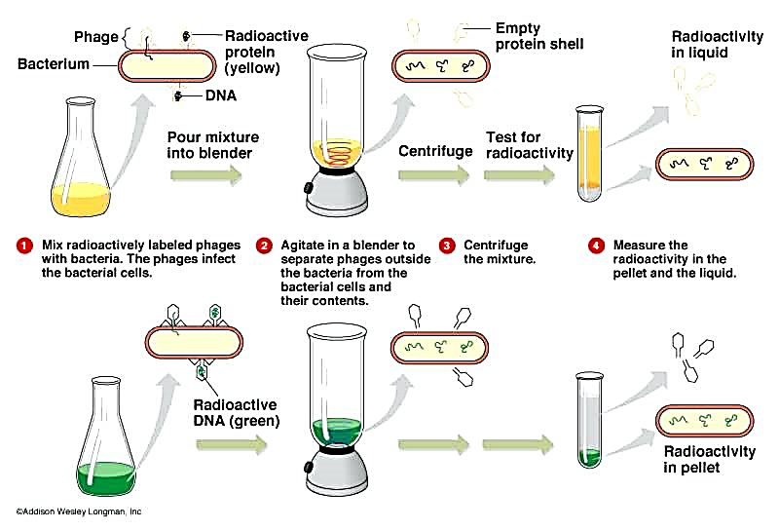
Hershey and Chase
1952
Blender Experiment

Slide 9
Erwin Chargaff
1950
Found that strands were always same distance apart
Also, that the amount of A always the same as amount of T
Amount of G always same as amount of C
Therefore: Purines must always bind to Pyrimidines
A binds to T; G binds to C

Slide 10
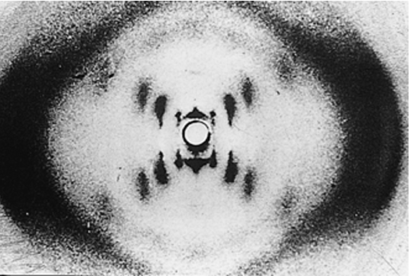
Rosalind Franklin
1953
Crystallized DNA and X-ray diffraction
From picture it was clear that DNA was in a helix
With symmetrically organized bases in center

Slide 11
Watson and Crick
April 25th, 1953
Seen Franklin’s picture:
Assumed Sugar-Phosphate backbone
Knew Chargaff’s rule:
A&T, G&C must covalently bind each other
Determined turning radius of beta-Helix
Realized it must be two complementary strands because of base pairing
Determined it was a double Helix

Slide 12
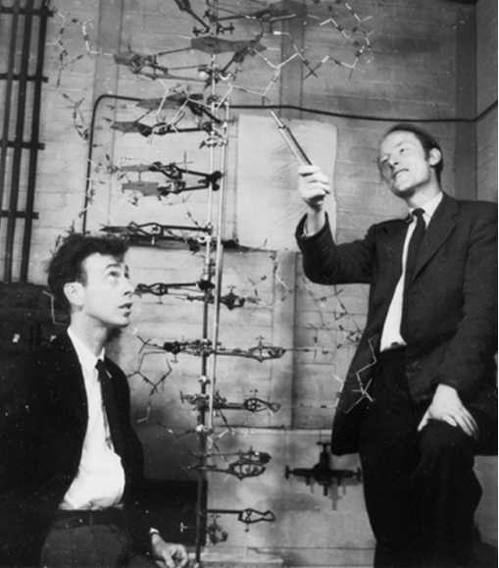
Watson and Crick
James Watson
American
Francis Crick
English

Slide 13
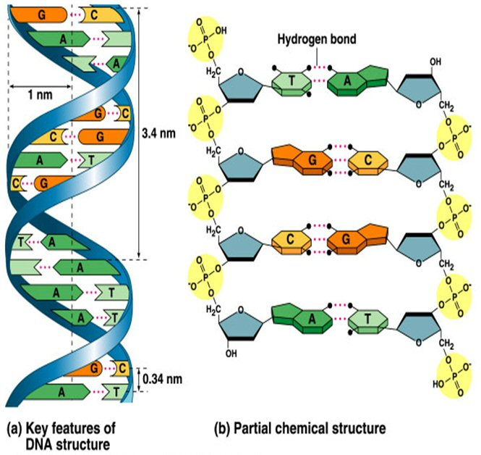
Hydrogen Bonds

Slide 14
Histones & Coils

Slide 15
DNA ~ Essential Functions
Genetic material inside a cell serves 4 essential functions:
Stores enough genetic material to construct an entire organism
Copies accurately
Can pass from parent to offspring
Accounts for the known variation within and among species
Chromosomes ~ cellular structures that contain genetic material; contain both DNA itself and proteins

Slide 16
Chromosomes vs. Chromatids
Notes:
Helicases form replication fork at the section of DNA to be copied

Slide 17
Karyotype

Slide 18
DNA Replication
Notes:
Helicases form replication fork at the section of DNA to be copied

Slide 19
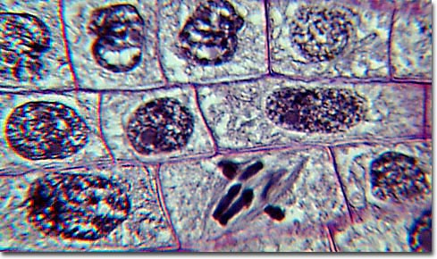
Mitosis ~ Cellular Division

Slide 20
Binary Fission
Notes:
Helicases form replication fork at the section of DNA to be copied

Slide 21
Cell Cycle

Slide 22
Mitosis
Mitosis ~ division of sister chromatids
~ yields two genetically identical nuclei
~ after we copy the DNA,
~ we must split the copies so each cell gets its own copy!
4 steps of Mitosis
Prophase
Metaphase
Anaphase
Telophase

Slide 23
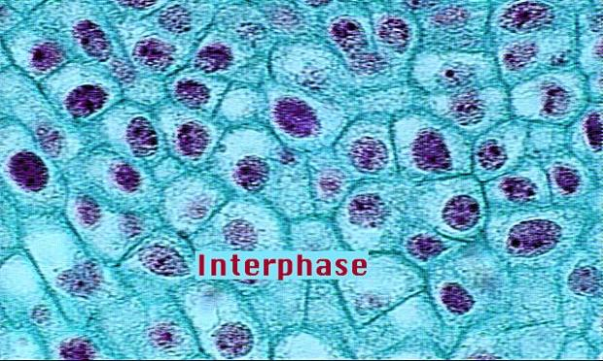

Slide 24
Late Interphase
Notes:
During late interphase, before the start of mitosis, duplicated chromatin is condensing into chromosomes, and centrosomes have duplicated in preparation for mitosis.

Slide 25
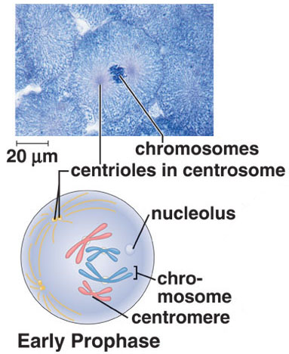
Prophase
DNA condenses into chromosomes
Centrioles migrate to opposite sides
Spindle begins to form
Nucleus and Nucleolus break down
Notes:
During late prophase, the spindle is forming and spindle fibers appear between the separating chromosomes. Centromeres attach to spindle fibers called centromeric (or kinteochore) fibers. The chromosomes have no particular orientation as yet.

Slide 26
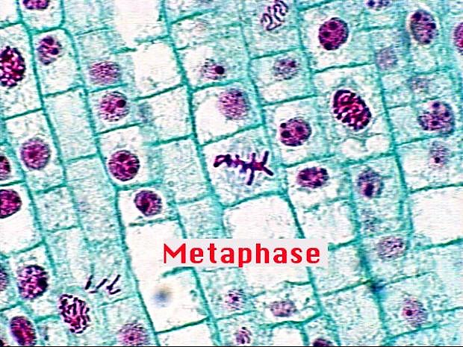

Slide 27
Metaphase
Spindle microtubules push and pull chromosomes to align them down the center of the cell
Notes:
By the time of metaphase, the fully formed spindle consists of poles, asters, and fibers. The metaphase plate is a plane perpendicular to the axis of the spindle and equidistant from the poles. The chromosomes attached to the centromeric spindle fibers line up at the metaphase plate during metaphase. Polar spindle fibers reach beyond the metaphase plate and overlap.

Slide 28
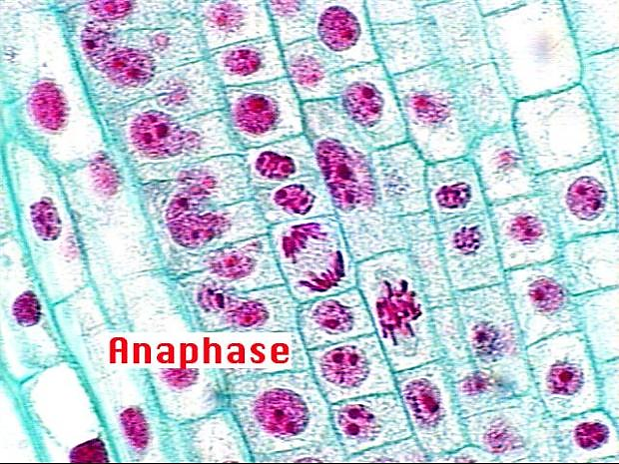

Slide 29
Anaphase
Sister chromatids are pulled apart and centromere is broken
Unattached fibers lengthen to stretch cell
Notes:
During anaphase, daughter chromosomes (each consisting of one chromatid) are moving toward the poles of the spindle. The daughter chromosomes have a centromere and a single chromatid. The movement of the daughter chromosomes occurs because the centromeric spindle fibers disassemble at the region of the centromere, pulling the daughter chromosomes toward the poles, and because the polar spindle fibers push the poles apart as they lengthen and slide past one another.

Slide 30
Telophase
Nucleus and nucleolus re-form
Chromosomes unwind
Notes:
During telophase, the spindle disappears, and the nuclear envelopes begin to reform around daughter nuclei. Each 2n daughter nucleus contains the same numbers and kinds of chromosomes as the original 2n parental cell.
Chromosomes become diffuse chromatin again, and a nucleolus appears in each daughter nucleus. At this point, cytokinesis is also nearly complete.

Slide 31
Cytokinesis
Cytokinesis ~ yields 2 daughter cells
Slightly different in plants & animals
Animal cells simply pinch in to create a cleavage furrow
Plants have a cell wall
To separate the 2 cells, they form a new cell wall in between the daughter cells called a cell plate
Notes:
A single cell becomes two cells by a furrowing process. A contractile ring composed of actin filaments gradually gets smaller, and the cleavage furrow pinches the cell into two cells.

Slide 32
Summary of Mitosis Stages
Interphase
Prophase
Metaphase
Anaphase
Telophase

Slide 33
Meiosis

Slide 34
Terminology
Diploid
two sets of chromosomes (2n)
in humans 23 pairs or 46 total
Haploid
one set of chromosomes (n)
gametes or sex cells
in humans 23 chromosomes

Slide 35
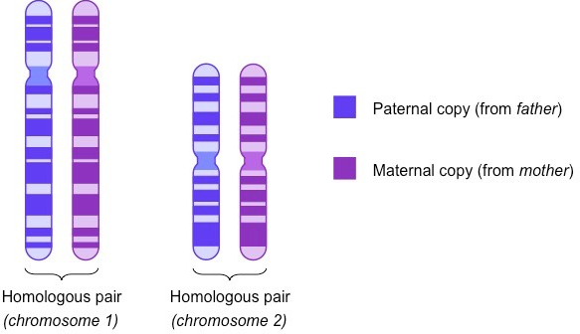
Terminology
Homologous pair
each chromosome in pair are identical to the other
( carry genes for same trait)
only one pair differs - sex chromosomes X or Y

Slide 36
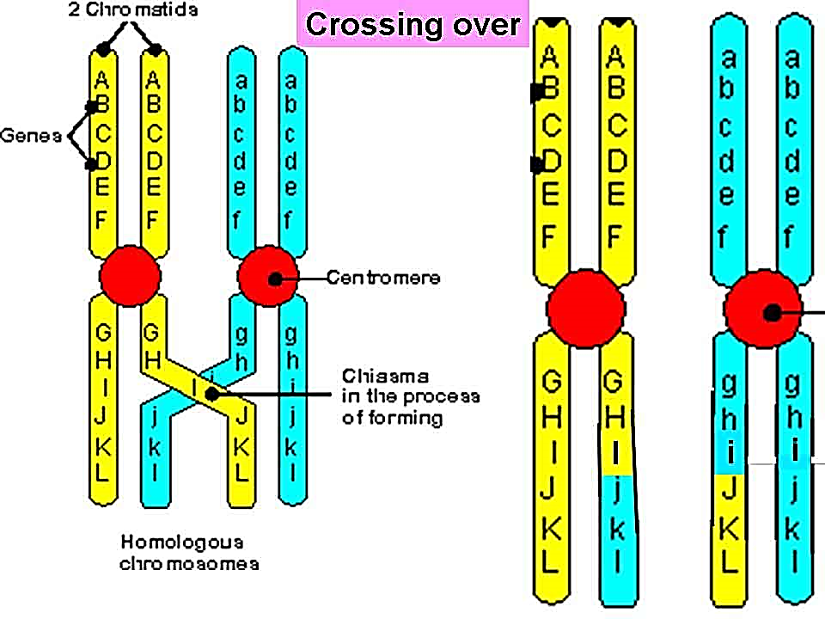
Terminology
Synapsis - pairing of homologous chromosomes forming a tetrad.
Crossing over - chromatids of tetrad exchange parts.

Slide 37
Phases of Meiosis
A diploid cell replicates its chromosomes
Two stages of meiosis
Meiosis I and Meiosis II
Only 1 replication

Slide 38
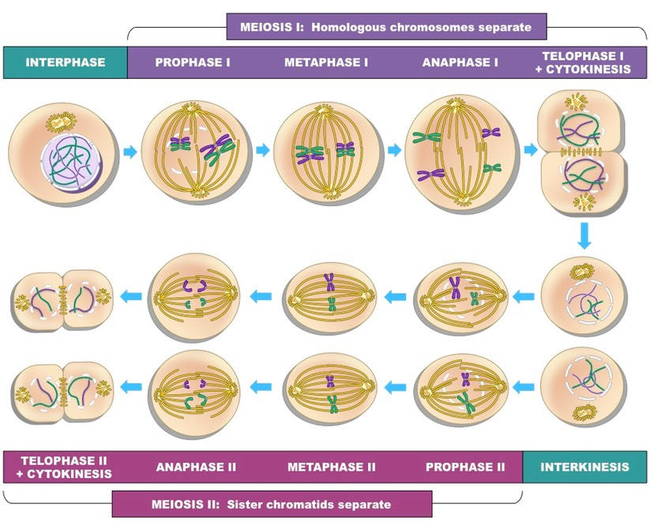
Meiosis
Notes:
During prophase I, the spindle appears while the nuclear envelope fragments and the nucleolus disappears. Because DNA replicated during interphase prior to meiosis I, the homologous chromosomes each have two sister chromatids. During synapsis, crossing-over can occur. If so, the sister chromatids of a duplicated chromosome are no longer identical.
During metaphase I, homologous pairs are aligned at the metaphase plate.

Slide 39
Mitosis vs. Meiosis
1n
Daughter cells different from parent cell and from each other.
Daughter cells have ½ the number of chromosomes as somatic cell.
Shuffling the genes
(Mix it up!)
2n
Clone
Same genetic information in parent cell and daughter cell.
Give me another one just like the other one!

Slide 40
Genetic Recombination
There are two sources of genetic recombination during meiosis:
crossing-over of non-sister chromatids and
independent assortment of homologous chromosomes.
Both events assure new genetic combinations in the offspring.

Slide 41
Synapsis and crossing-over
Notes:
During meiosis I, from left to right, duplicated homologous chromosomes undergo synapsis; nonsister chromatids break and then rejoin, so that two of the resulting daughter chromosomes have a different combination of genes.

Slide 42
Mutations
Notes:
During meiosis I, from left to right, duplicated homologous chromosomes undergo synapsis; nonsister chromatids break and then rejoin, so that two of the resulting daughter chromosomes have a different combination of genes.

Slide 43
Genetics

Slide 44
History of Genetics

Slide 45
Terms to Know
Inheritance
Acquisition of traits passed from parents to offspring
Hybridization
2 individuals with different characteristics are mated
Characters
general features of an organism
Traits
identifiable characteristic of an organism

Slide 46
Terms to Know
Self- fertilization
same plant has male and female gametes
True-breeding line
continues to exhibit the same trait after several generations of self-fertilization
Cross fertilization
mating plants that differ by some trait

Slide 47
Terms to Know
Allele
variant form of a gene
Homozygous Dominant
2 of the same DOMINANT alleles (Ex. RR)
Homozygous Recessive
2 of the same recessive alleles (Ex. rr)
Heterozygous
1 dominant and 1 recessive allele (Ex. Rr)

Slide 48
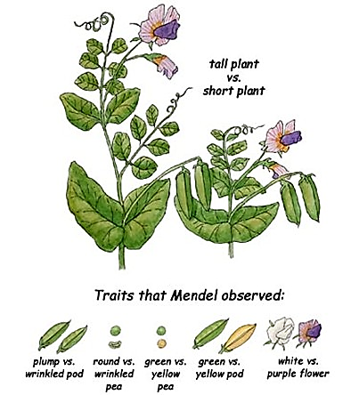
Characteristics Mendel Studied

Slide 49
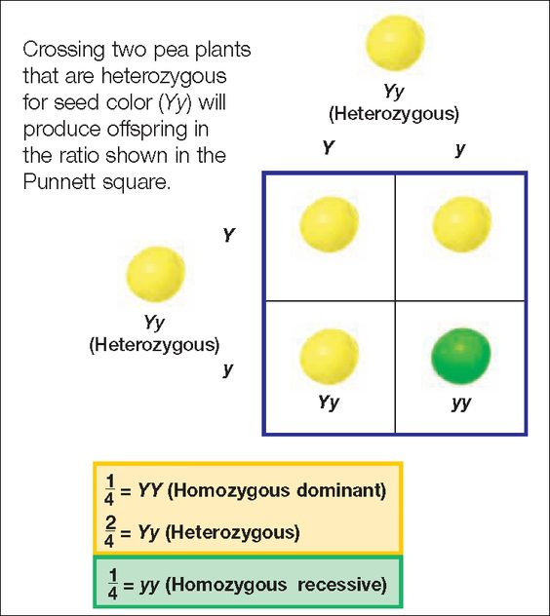
Monohybrid Cross
Notes:
Test Cross

Slide 50
Monohybrid Cross- Practice
In humans, the allele for free hanging ear-lobes (E) is dominant over the allele for attached earlobes (e). Two heterozygous individuals are crossed. What are the resulting genotypic and phenotypic ratios for their offspring?

Slide 51
Law of Segregation

Slide 52
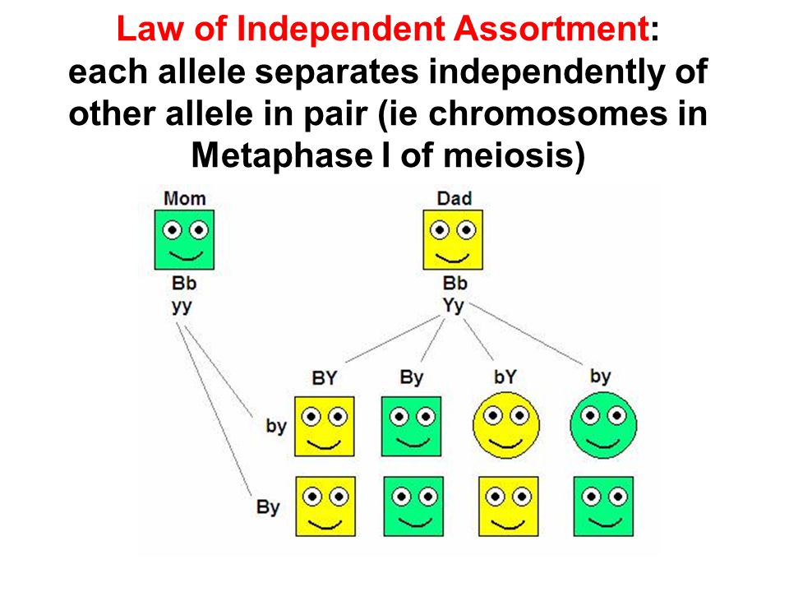
Law of Independent Assortment

Slide 53
Laws
Chromosome Theory of Inheritance
Chromosomes are made of DNA which contains genes
Chromosomes are copied and passed from parent to offspring
A diploid nucleus contains 2 sets of chromosomes found in homologous pairs

Slide 54
Laws
Chromosome Theory of Inheritance
At meiosis one member of each pair goes to one daughter cell. The chromosome pairs move independently of each other
Gametes are haploid cells that combine to form diploid organisms with each gamete contributing to one set of chromosomes in the offspring

Slide 59
Dihybrid Cross Practice
A heterozygous tall, yellow-seeded plant is crossed with another heterozygous tall, yellow-seeded plant. What is the phenotypic ratio of the resulting offspring?

Slide 60
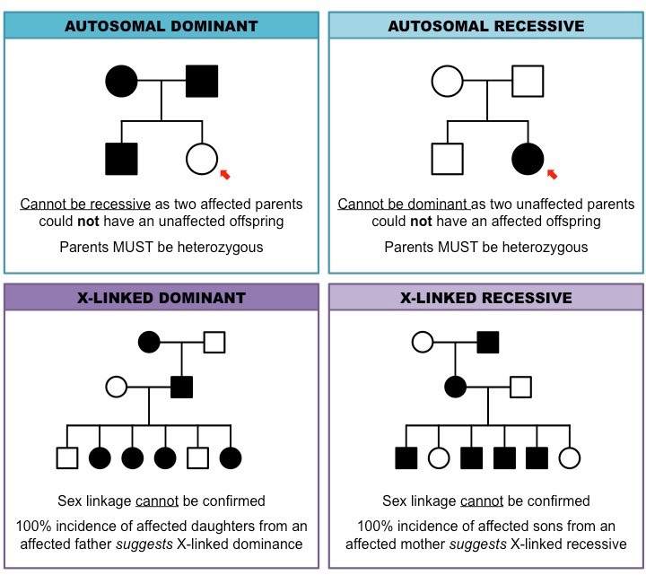
Pedigrees
Diagram that tracks appearance of a particular trait (usually a disease) in Humans

Slide 61
Sex Linked traits
Sex Linked
Genes found on one sex chromosome but not the other (typically the X chromosome)
Because boys only inherit 1 X chromosome, they are more likely to have a sex-linked chromosomal disease
1 mutation can have more than 1 consequence
A single gene can affect a cell in more than 1 way
A gene can be expressed in different cell types
A gene may be expressed at various stages of development

Slide 62
Sex Linked traits

Slide 63
Sex Linked traits

Slide 64
Sex Linked traits

Slide 65
Genetic Disorders

Slide 66
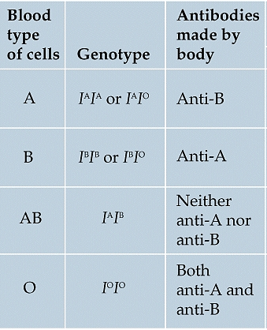
Blood Type

Slide 67
